Slide 1


Virtual Commissioning
Demonstrator using TS2 components

Slide 2
Introduction
The goal of the work package is to evaluate the data basis, define a development environment, and implement a proof-of-concept for a standardized virtual commissioning with operational PLC function blocks for Transfer System TS2 with selected material flow scenarios.
After the implementation of the PoC, the concept is generalized to all standardizable material flow scenarios and expanded to the entire TS2 library in Visual Components.

Slide 3
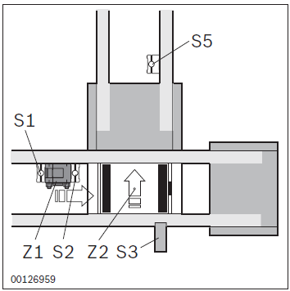
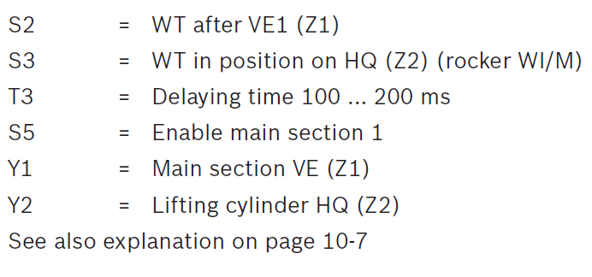
TS2 Fundamental Function Plans
Introduction
The use case scenarios chosen for this are the fundamental function plans for control tasks defined for the TS2 Lift Transfer Unit as per the product catalogue, such as:
TFE1 : Implementation in transverse section
The material flow in this function plan consists 1 entrance from longitudinal section to the 1 transverse exit to the left or right port of the LTU.
The sensors S1,S2 and S5 determines the opening and closing of the stopper Y1.
Sensor S3 determines the lifting up and down of the lifting cylinder Y2.

Slide 4
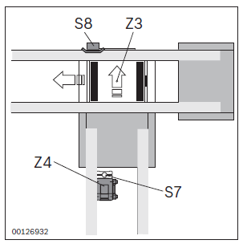
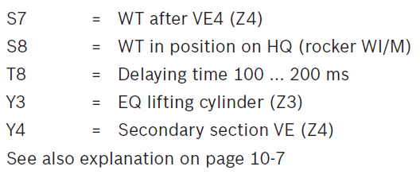
TS2 Fundamental Function Plans
Introduction
2. TFE2 : Implementation in longitudinal section
The material flow in this function plan consists 1 entrance from transverse section to the 1 longitudinal exit to the front or back port of the LTU.
The sensors S7 determines the opening and closing of the stopper Y4.
Sensor S8 determines the lifting up and down of the lifting cylinder Y4.

Slide 5
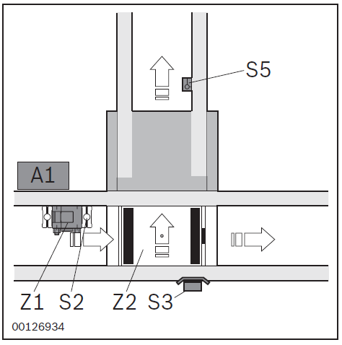
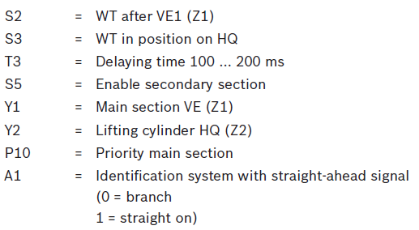
TS2 Fundamental Function Plans
Introduction
3. TFE3 : Transverse conveyor (separating, outfeeding)
The material flow in this function plan consists 1 entrance from longitudinal section to the 2 exits to either transverse (Left/Right ports) or longitudinal (Front/Back) port of the LTU.
The sensors S2,S5 determines the opening and closing of the stopper Y1.
Sensor S3 determines the lifting up and down of the lifting cylinder Y2.
Routing to branch or straight is based on identification system with straight signal A1 (0= Branch, 1 = Straight On)
Y2.1 S, Y2.2 R = Lift is UP
Y2.2 S, Y2.1 R = Lift is DOWN
Y2.1 AND Y2.2 Reset = Lift is in MIDDLE position

Slide 6
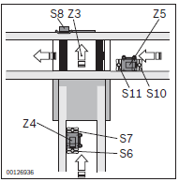
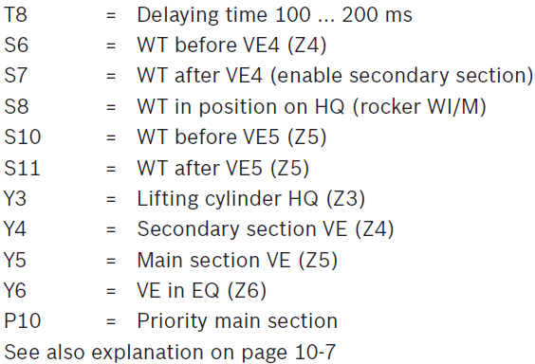
TS2 Fundamental Function Plans
Introduction
4. TFE4 : Transverse conveyor (separating, infeeding)
The material flow in this function plan consists 2 entrance from longitudinal and transverse section to the 1 exit to longitudinal section (Front/Back) port of the LTU.
The sensors S6,S7 & S10,S11 determines the opening and closing of the stoppers Y4 and Y5, respectively.
Sensor S8 determines the lifting up and down of the lifting cylinder Y3.
Routing from branch or main section is based on Priority main section variable P10 (0= From branch, 1 = From main section)
Y3.1 S, Y3.2 R = Lift is UP
Y3.2 S, Y3.1 R = Lift is DOWN
Y3.1 AND Y3.2 Reset = Lift is in MIDDLE position

Slide 7
Development Plan for TS2 Library
Overview
Software Environment
WP1
(Virtual ctrlX, OPC Server App, OPC Connection Visual Components)
• Development environment
Simulation Objects
WP2
• List of components, list variables and properties, evaluate Python code (internal component mechanism)
Working Packages
Screening of Product Documentation
WP3
• I/O signals, sequence of actions, node variance (basics and extensions)
Simulation Objects Visual Components Evaluation
WP4
• Comparison of I/O signals and simulation variables, comparison of sequence of actions with simulation mechanism
Demonstrator
WP5
• Layout definition (Drive Unit > Lift Transfer Unit > Drive Unit), PLC code, Simulation model

Slide 8
WP1: Software Environment
Development Plan for TS2 Library
Setting up of virtual environment in ctrlX WORKS, using PLC engineering for process control, OPC UA as the communication protocol and Visual Components for material flow simulation.
Key steps involve: Creating virtual environment in ctrlX WORKS > Installation of ctrlX Automation apps > Configuration of PLC > Writing PLC code > OPC UA server configuration > Variable mapping in Visual Components.
Reference: Implementation Simulation Demo ctrlX

Slide 9
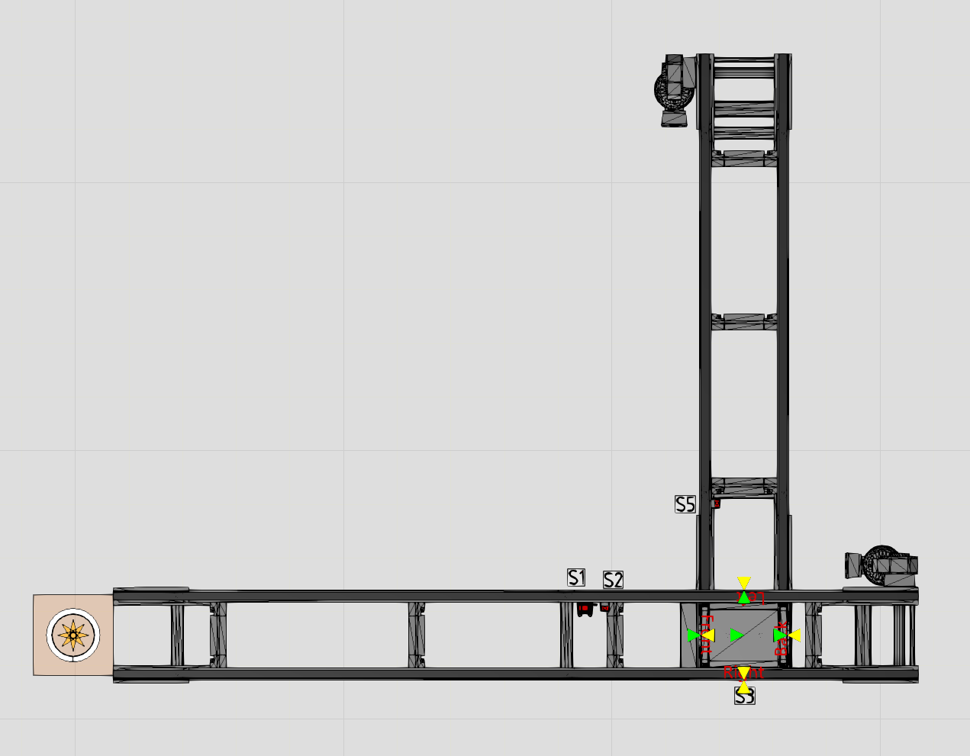
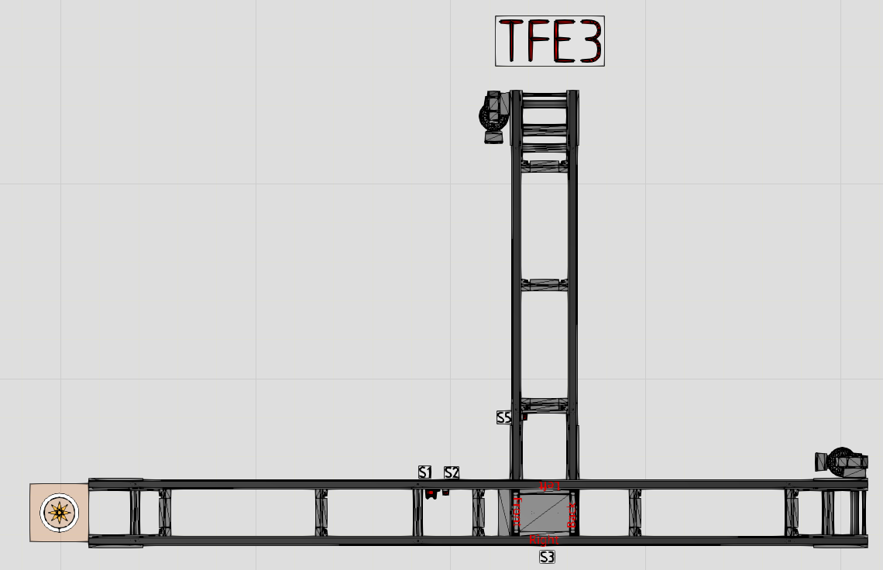
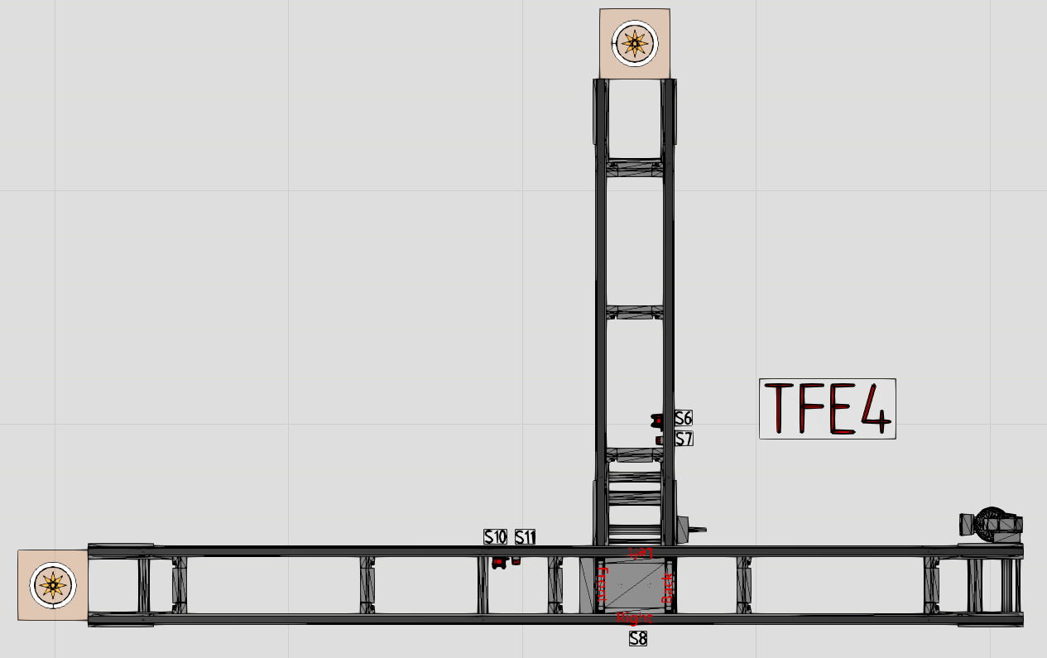
WP1: Software Environment
Development Plan for TS2 Library
For each fundamental function plan corresponding layout is modelled in Visual components using TS2 library components.
Fig. VC simulation models for function plans TFE1, TFE3 & TFE4 respectively

Slide 10
WP2: Simulation Objects
Development Plan for TS2 Library
Involves creation of a list of TS2 components specifically used for the creation of the demonstrator models.
Creation of list of variables and properties concerning the virtual commissioning of the component.
Evaluation of the python script for each component to evaluate the internal control mechanism of these selected components.

Slide 11
WP3: Screening of Product Documentation
Development Plan for TS2 Library
Involves definition of I/O signals of the components.
Evaluation of sequence/flow of actions.
Evaluation of node variances (basics and extensions)

Slide 12
WP4: Simulation Objects Visual Components Evaluation
Development Plan for TS2 Library
Comparison of I/O signals of TS2 components and simulation objects.
Comparison of sequence of actions with internal control mechanisms of simulation objects.

Slide 13
WP5: Demonstrator
Development Plan for TS2 Library
Definition of layout: drive unit -> lift transfer unit (direction: left) -> drive unit
Creation of simulation model (Visual Components)
Implementation of PLC code (ctrlX, function blocks)
Execution of test run

